Slide 1
Step Into Java:
Elevens Card Game
Let’s Write It!
Mr. Neat
Java

Slide 2
Elevens – Engine Structure
Given a partial class (ElevensBoard.java)
Open it an read it over…

Slide 3
Elevens – Engine Structure
Note the private methods
- there are 3
- called “helper” methods
- only called by public methods in
ElevensBoard.java
Figure out what public methods will call
the “helper” methods

Slide 4
Elevens – Engine Structure
Let’s compare and contrast two private
methods:
public boolean isLegal(List<Integer> selectedCards)
and
public boolean anotherPlayIsPossible()

Slide 5
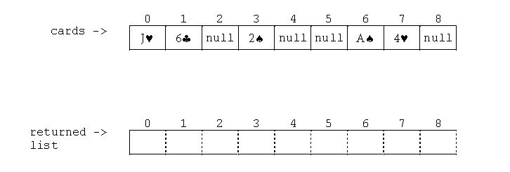
Elevens – Engine Structure
Let’s look at the method:
public List <Integer> cardIndexes()

Slide 6
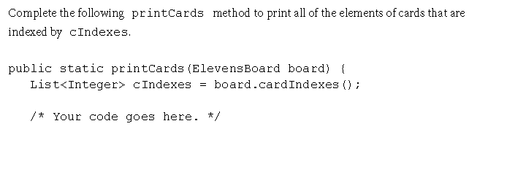
Elevens – Engine Structure

Slide 7
Elevens – Code Reusability
There are other card games like 21, tens, thirteens,…
Some of the code in elevensBoard could be used by other games
Wouldn’t it be nice is the basic structure for your game was already setup? You just need to write the code unique to your game

Slide 8
Elevens – Code Reusability
What is common to these games?
Let’s look at the elevensBoard.java file…

Slide 9
Elevens – Code Reusability
What is the mechanism we can use to group the common code?....
Inheritance!
Specifically, this is where an abstract class
would be perfect!

Slide 10
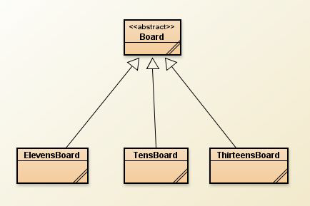
Elevens – Code Reusability

Slide 11
Elevens – Code Reusability
Contents of original elevensBoard.java
can be divided into 3 categories:
1) common to all solitaire games
2) common to all but what it does is
unique to each game
3) unique to each game

Slide 12
Elevens – Code Reusability
Yeah…Inheritance…a real cool thing
about Java!
common
stuff
unique
stuff

Slide 13
Elevens – Code Reusability
Yeah…Inheritance…a real cool thing
about Java!
abstract
stuff

Slide 14
Elevens – Code Reusability
Yeah…Inheritance…a real cool thing
about Java!
GUI
isLegal()
(abstract)
isLegal()
(concrete)
isLegal()
(concrete)
isLegal()
(concrete)

Slide 15
Elevens – Code Reusability
Yeah…Inheritance…a real cool thing
about Java!
GUI
isLegal()
(abstract)
Polymorphism!
isLegal()
(concrete)
isLegal()
(concrete)
isLegal()
(concrete)

Slide 16
Lab – Complete Elevens!
Note:
You have the option of using the “standard” code folder or the “expert”
In the standard, I give you a working Card.java and Deck.java
In the expert, you use your own version of these 2 files.
A recommended approach would be to use “standard” to start and then switch to “expert” after “standard” is successfully running

Slide 17
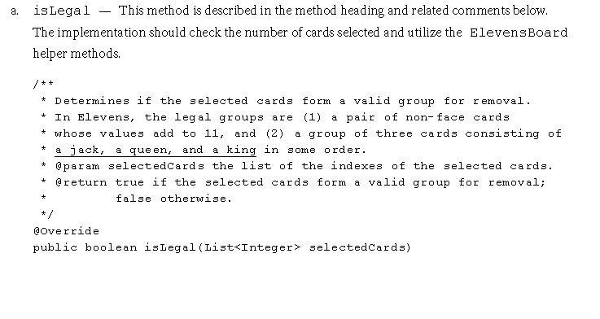
Lab – Complete Elevens!
Write the following methods:

Slide 18
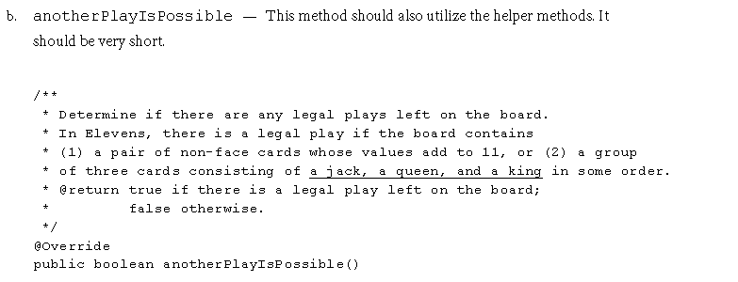
Lab – Complete Elevens!
Write the following methods:

Slide 19
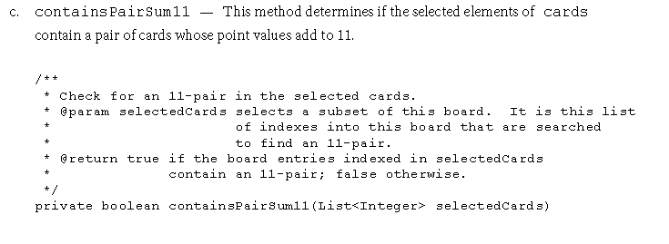
Lab – Complete Elevens!
Write the following methods:

Slide 20
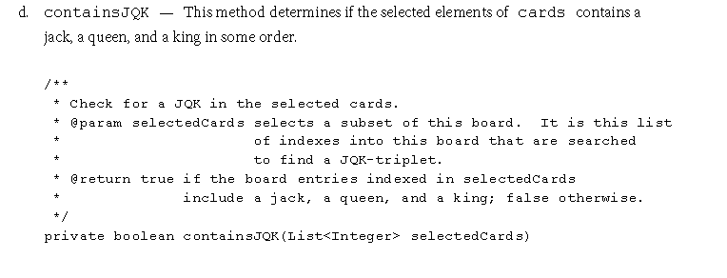
Lab – Complete Elevens!
Write the following methods:

